Slide 1
Expert search
554 – Information Retrieval
In uw directory
Dhinesh Kumar Prasath
Sagar Kamboj
Sanjeev Kamboj

Slide 2
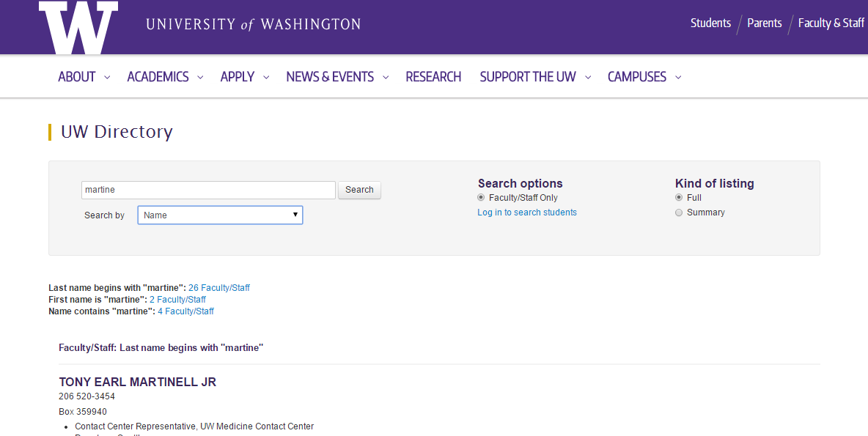
MOTIVATION

Slide 3
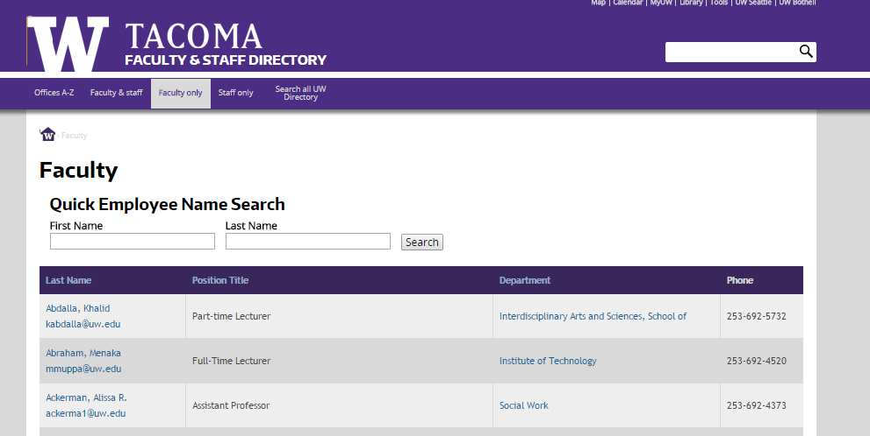
MOTIVATION

Slide 4
motivation
UW
Offers search based on the following parameters
Name
Department
Email
Box Number
Phone
UW Tacoma
Name – First & Last
What if I am new?
What if I don’t know any of these details?
Can I find a faculty based on their area of expertise?
Not possible in the current system
Solution: Come up with an expert search system which does search the directory based on their respective area of expertise – Expert Search

Slide 5
EXPERT SEARCH – GOALS & assumptions
Allow the user to search the directory based on the area of expertise
If more experts are found, then rank them based on their Research contributions and publications
Limited to UW Tacoma as of now
Should enable Name search
Should enable Department search
Should enable other possible search criteria as well
Provide an easy, presentable and more intuitive UI so that users will not have any issues in finding what they need
Make the system available online

Slide 6
Phases
Creating the required Corpus
Creating a required suitable Index (Controlled vocabulary Creation, Offline)
Crawling (Offline) for data retrieval
Dynamic Indexing of matching documents
Dynamic Ranking
Building an intuitive User Interface – To query & display the results

Slide 7
Process flow
Begin querying the UW directory
User queries the system
Display the returned results to the user
Get the complete staff list, format and generate list of faculty homepages
Query the relevant links from DB
Return the results to the UI
User Interface
For each record, crawl their home pages and get photos and all details
Search criteria Expertise based
Gather all the relevant information to be displayed
File
Storage
NO
Store everything offline – images and content
Database
YES
Create & store controlled vocabulary index
Add it to Lucene for ranking
Sort the results based on the returned ranking
End querying the UW directory
Corpus & Index creation
Ranked retrieval & formatting results

Slide 8
Corpus & Index creation
Analyzed various web crawlers – Heritrix, HTTack and web-based crawlers; Used HTTrack to mirror the website – faculty.Washington.edu. The results were inconclusive. It was not retrieving all the required relevant pages.
Used a different strategy; Concentrated only on UW Tacoma faculty list; Retrieved a complete list of faculty members; - 377 of them with few duplicates (6 duplicates to be exact)
Retrieved directory data for all these faculty records including the following fields:- Name, Position, Department, Phone Number, UW NetID, UW mail, Photo and their home page.
Queried their home pages based on their UW Net Id. Found only few of them have active web pages and web publishing enabled.
Out of the published home pages, many of the pages are just place holders.
For the valid home pages, started with controlled index creation based on their projects, published and contributed papers, research work, teaching etc.
Stored the content to the file system – images and web content
Stored all the details and the created index to the database

Slide 9
Dynamic Ranking retrieval System
Use Lucene for indexing- uses inverted indexing: if a number of search terms map to same document, then document is likely to be relevant
Lucene search is done with a hybrid of Boolean model and Vector Space model
Default scoring uses TF-IDF – builds a RamDirectory object in memory for indexing.
Primarily Used Lucene as a Ranking system rather than an indexing structure
Retrieve from a Mysql database –> store information in a Faculty object -> add id and homepage text in Lucene -> homepage text is tokenized

Slide 10
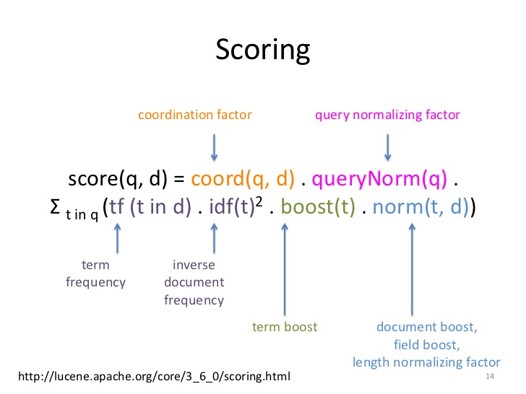

Scoring
tf.*idf
Scoring Documents dependant on how documents are indexed.
Document is collection of field, which can be tokenized and untokenized

Slide 11
User Experience – Querying & Displaying Result
Made a user-friendly, simple interface that was easy to visually understand.
Contains a drop-box that contains categories – Name, Expertise, Email, etc.
After clicking category on drop-down box, user can type in query accordingly.
Displays data in different clickable panels – Much like rich snippets
Went with a UW theme which has potential to be integrated with UWT website.

Slide 12
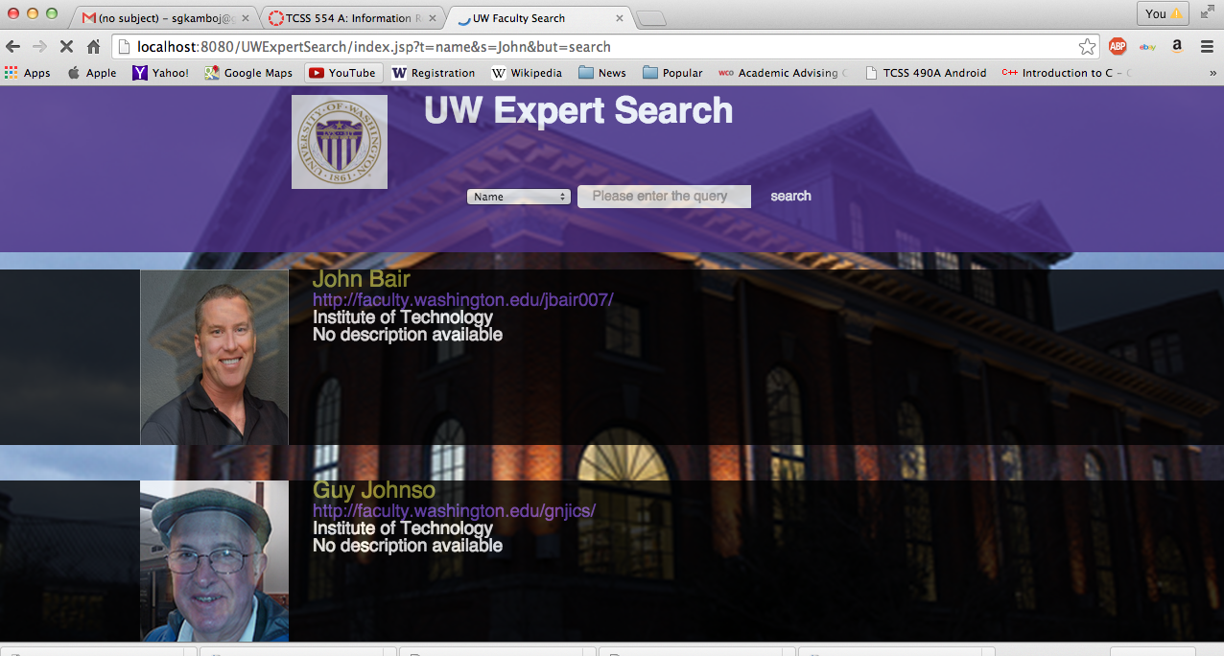

Slide 13
User Interface
Used JSP for the user interface – Initially was unsure how to run or make a JSP page.
Started out running tomcat separately with a different environment (Smultron).
Later started using Eclipse EE so integrating with back end would be easier.
Initially had problems because injecting Java into HTML was challenging.
Made an additional drop-down box that was supposed to be populated with departments.
Scrapped it after some consideration because results were not populating the page.

Slide 14
Challenges & limitations
Automatic crawler would have been the way to go. But it was not crawling data as expected. Had it been done with elevated privileges, with a faculty /staff logon, we would have saved lot of manual effort.
In conjunction with point 1, with automatic crawling this process could be extended to other UW locations as well – Bothell and Seattle.
Ultimately, everything depends on how much data is available in the faculty directory and their home pages. Limited data will return limited results. Only one-third of them have active home page links and only half of those links work or have tangible data.
Also the format of data presented in the home pages were not uniform. Certain home pages had all the information in the front page, certain or tabbed, some had outward links to other web pages and few had documents. This makes crawling and ranking difficult. So we have to normalize data when doing automatic crawling.

Slide 15
Future work
Shifting primary store to Apache SOLR – will index and store data in one storage structure, is distributed
Using Apache Lucene for Indexing as well thus enabling a better performance when it comes to integrating results of UW Bothell and Seattle.
Possibility of integrating with school website.
Adding more functionality such as auto-fill.

Slide 16
Questions & Comments
?????
Thanks!!!

